Slide 1
Spin-based Neuromorphic Computing (Simulation)
Chong Tian En

Slide 2
Neuromorphic Computing
Hardware based implementation of neural network
Application-Specific Integrated Circuit (ASIC)
Not for General Purpose Computing (Forget YouTube, Email, … etc)

Slide 3
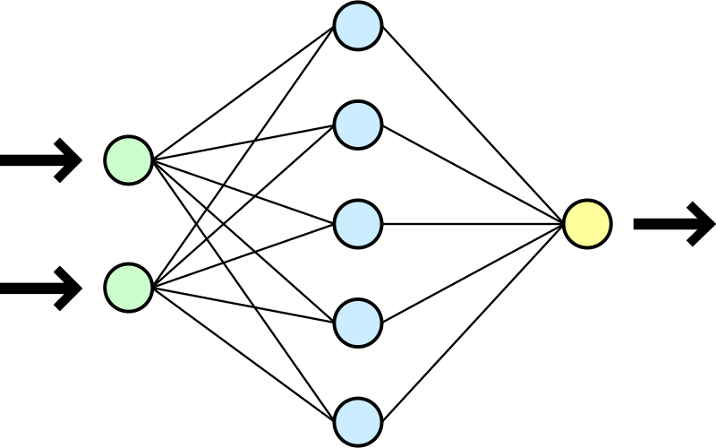
Neural Network

Slide 4
Why Neuromorphic Computing?
Huge application in AI Computer Vision
Mimic human brain neuron and synapse network
Very efficient for visual object recognition
Low power consumption
Deeper layer network can extract subtler visual details
Network output can be fed for image classification

Slide 5


Slide 6
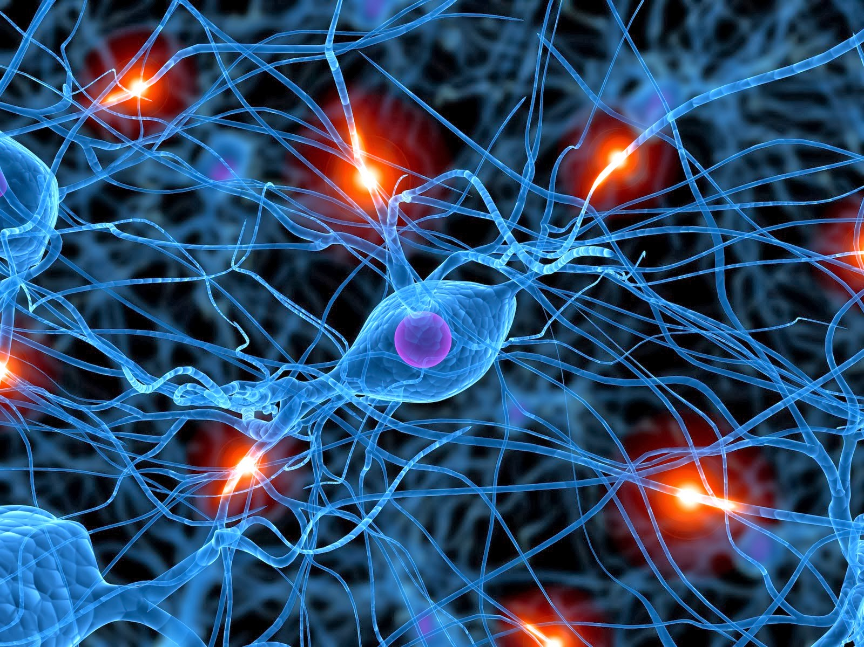

Slide 7
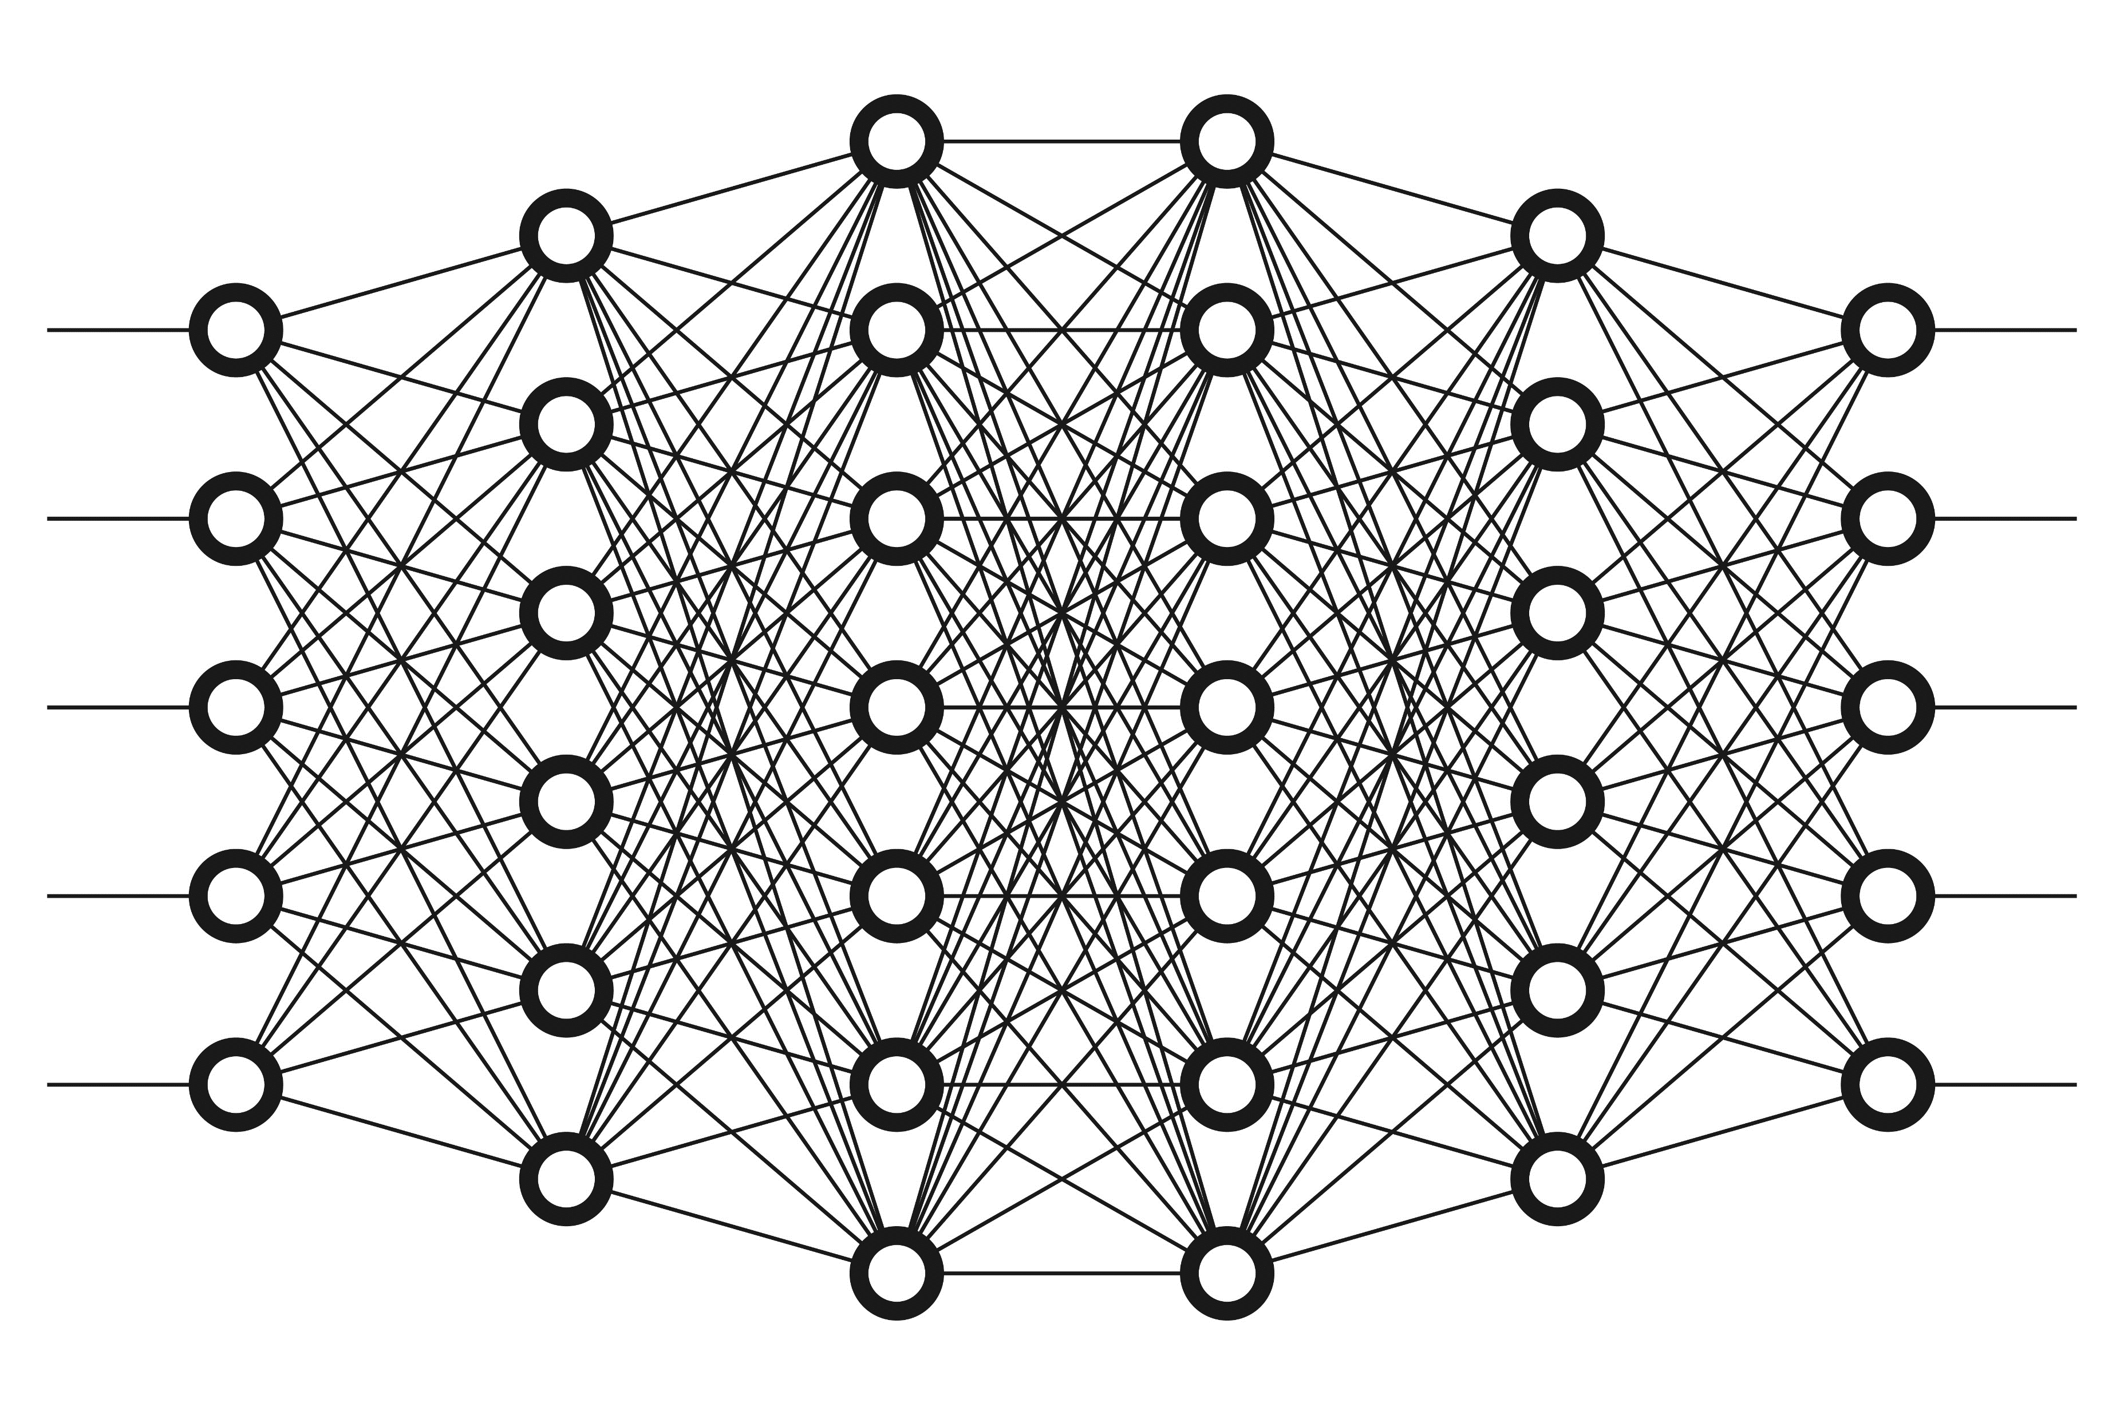

Slide 8
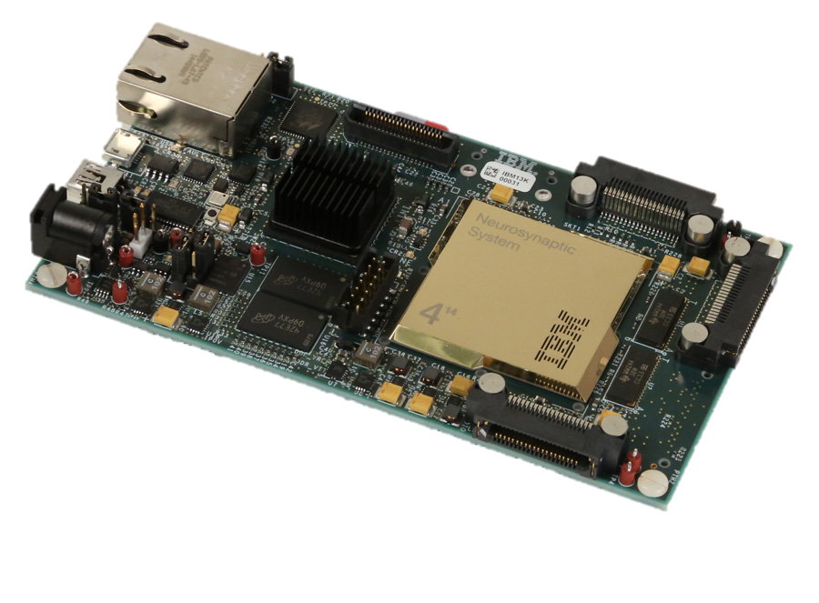
IBM TrueNorth Chip
4096 cores
256 neurons/core
256 synapses/neuron
Only consumes 63mW
"Neuromorphic Hardware: Trying To Put Brain Into Chips." Medium. N.p., 2019. Web. 18 Dec. 2019.

Slide 9
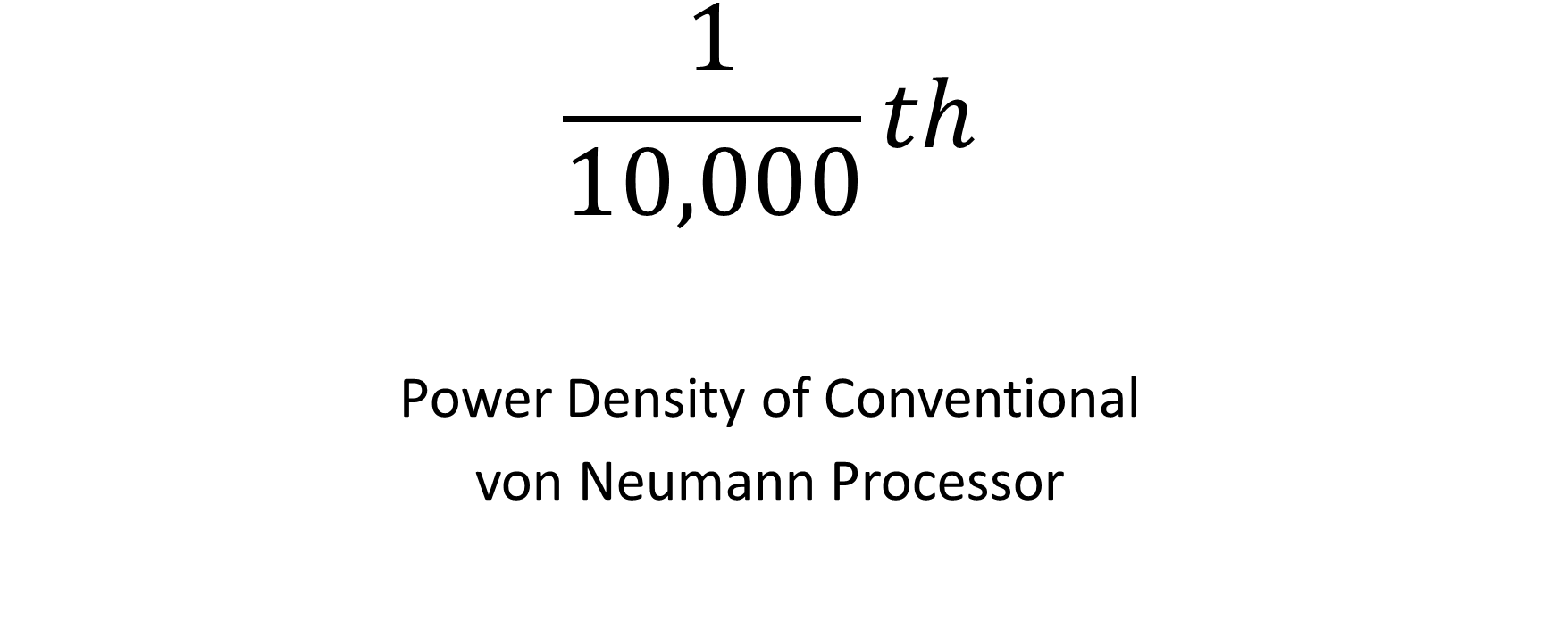
$$\frac{1}{10,000}th$$
Power Density of Conventional
von Neumann Processor
"Neuromorphic Hardware: Trying To Put Brain Into Chips." Medium. N.p., 2019. Web. 18 Dec. 2019.

Slide 10
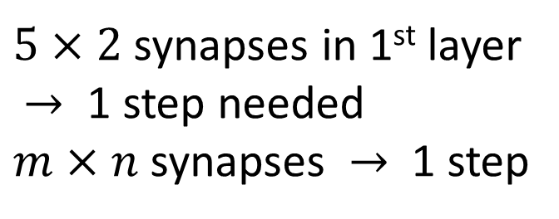
Neural Network
$5×2$ synapses in 1st layer
$→$ 1 step needed
$m×n$ synapses $→$ 1 step

Slide 11
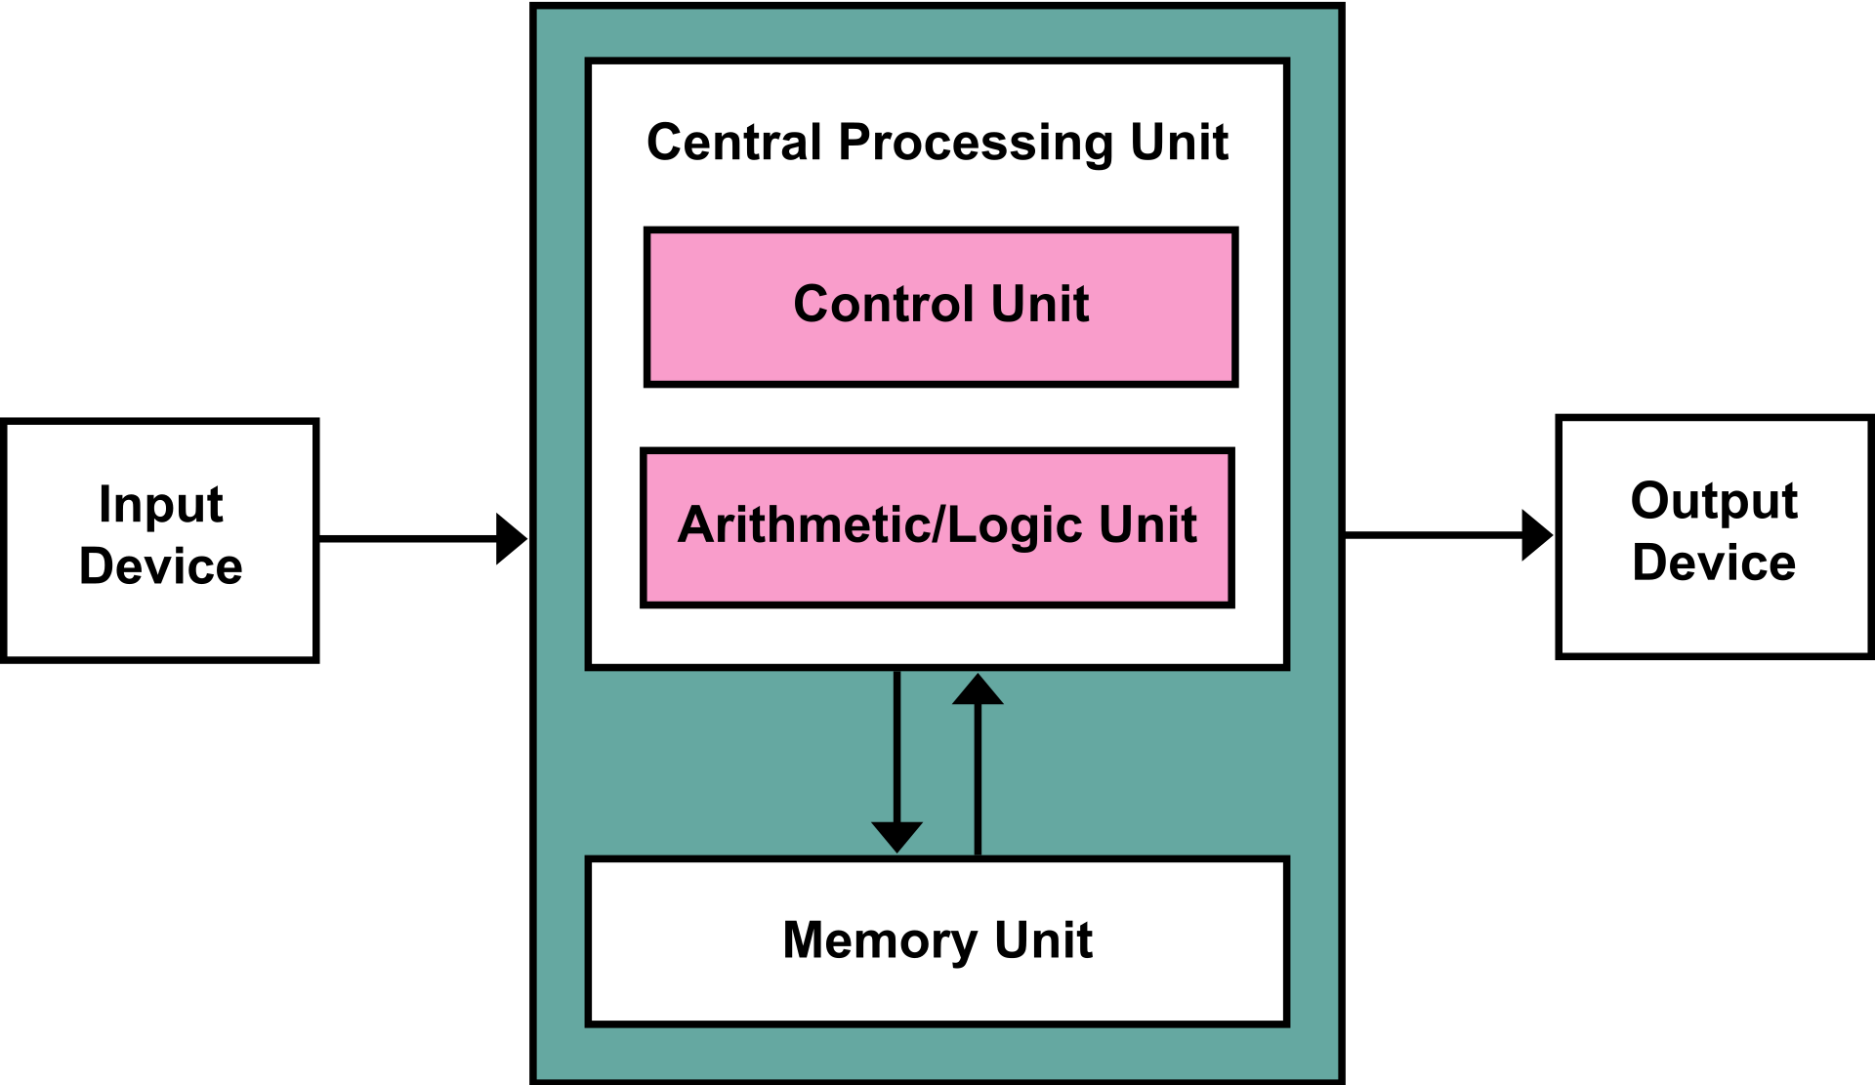
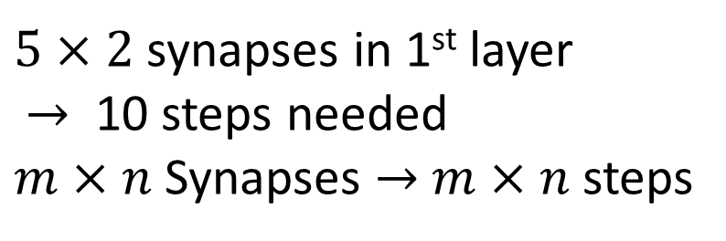
von Neumann Processor
$5×2$ synapses in 1st layer
$→$ 10 steps needed
$m×n$ Synapses $→$ $m×n$ steps

Slide 12
Motivation (Use of Spintronics)

Slide 13
Why Spin-based (Spintronics)?
Originally used in hard disk drive read/write head
Involve in:
Spin Transfer Torque(STT)
Spin Orbit Transfer (SOT)
Tunneling Magnetoresistance (TMR)
Giant Magnetoresistance (GMR)
for magnetoresistive application like Magnetoresistive Random-access Memory (MRAM)

Slide 14
Why Spin-based (Spintronics)?
Non-volatile (information retention during power loss) like Solid State Drive (SSD) unlike Metal Oxide Semiconductor (MOS) and Capacitors
Similar to SSD, MTJ uses electron tunnelling
MTJ has smaller footprint to CMOS (Main reason)
But, MTJ uses electron spin orientation instead of electron presence in SSD (charge retention changes threshold voltage, causing wear out)

Slide 15
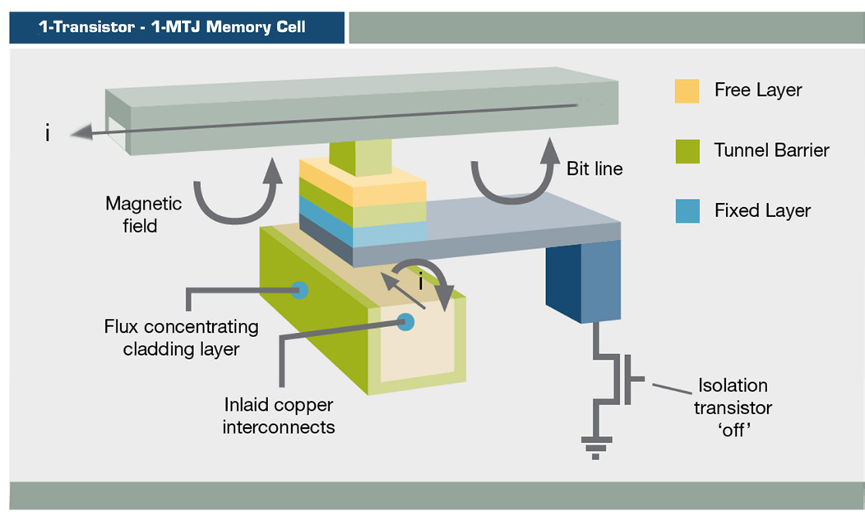
MTJ Memory Cell (Old model as Ilustration)

Slide 16
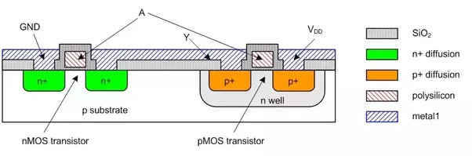
MOSFET (PMOS and NMOS)

Slide 17
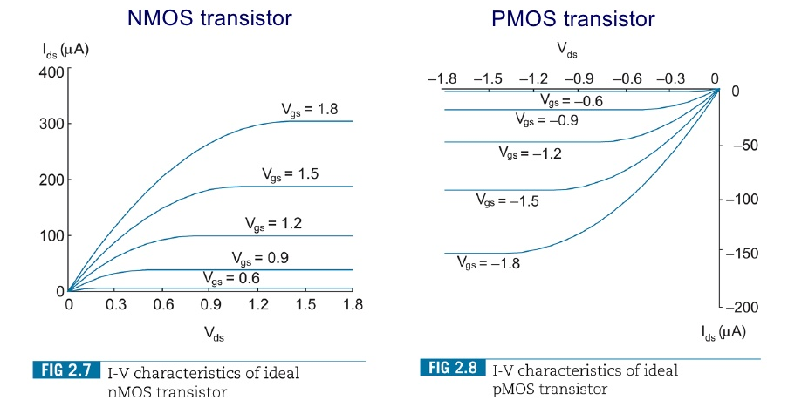
MOSFET IV Characteristics

Slide 18
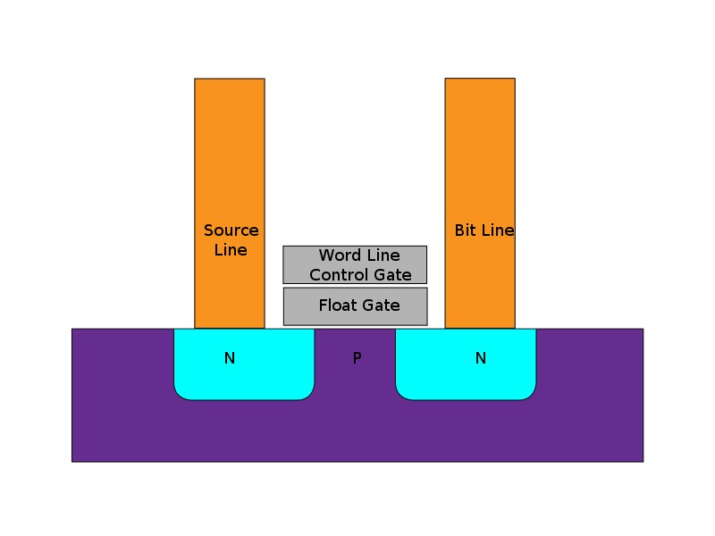
SSD Nand Flash

Slide 19
Spintronics Advantage vs Conventional SSD
Higher read/write speed
Lower power
No wear out (Unlimited read/write cycle)
"What is MRAM Memory Technology" Medium. N.p., 2019. Web. 18 Dec. 2019.

Slide 20
Simulation details

Slide 21
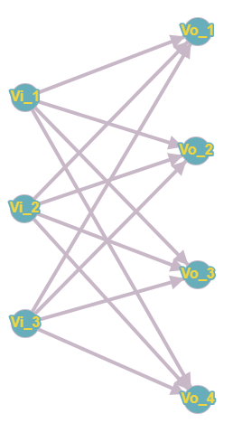
E.g. 3 by 4 Matrix

Slide 22
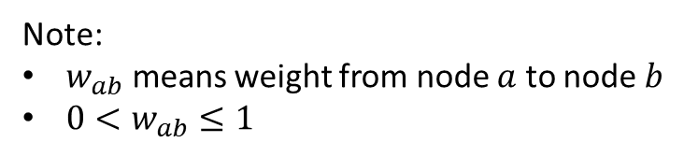
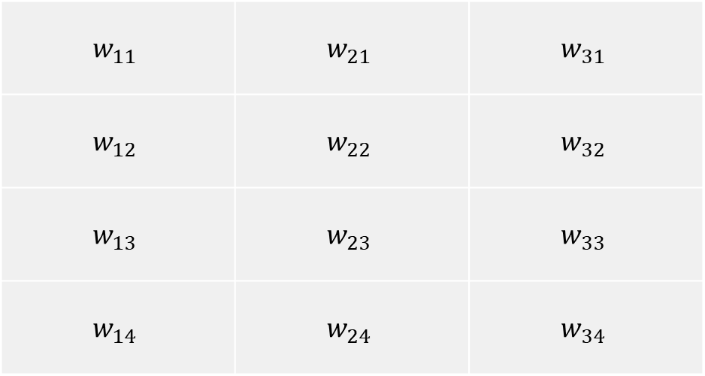
Weight (Continued)
$$w_{11}$$ | $$w_{21}$$ | $$w_{31}$$
$$w_{12}$$ | $$w_{22}$$ | $$w_{32}$$
$$w_{13}$$ | $$w_{23}$$ | $$w_{33}$$
$$w_{14}$$ | $$w_{24}$$ | $$w_{34}$$
Note:
$w_{ab}$ means weight from node $a$ to node $b$
$0<w_{ab}≤1$

Slide 23
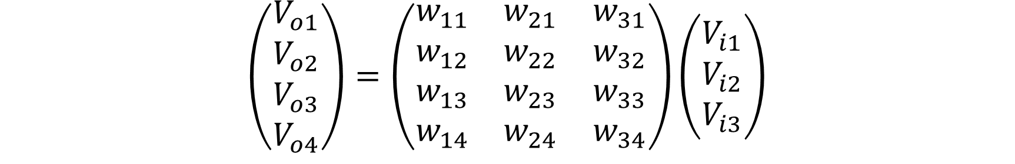
Theoretically and Ideally…
$$\left(\begin{matrix}V_{o1} \\ V_{o2} \\ V_{o3} \\ V_{o4}\end{matrix}\right)=\left(\begin{matrix}w_{11} & w_{21} & w_{31} \\ w_{12} & w_{22} & w_{32} \\ w_{13} & w_{23} & w_{33} \\ w_{14} & w_{24} & w_{34}\end{matrix}\right)\left(\begin{matrix}V_{i1} \\ V_{i2} \\ V_{i3}\end{matrix}\right)$$
Note:
Matrix in m by n dimension

Slide 24
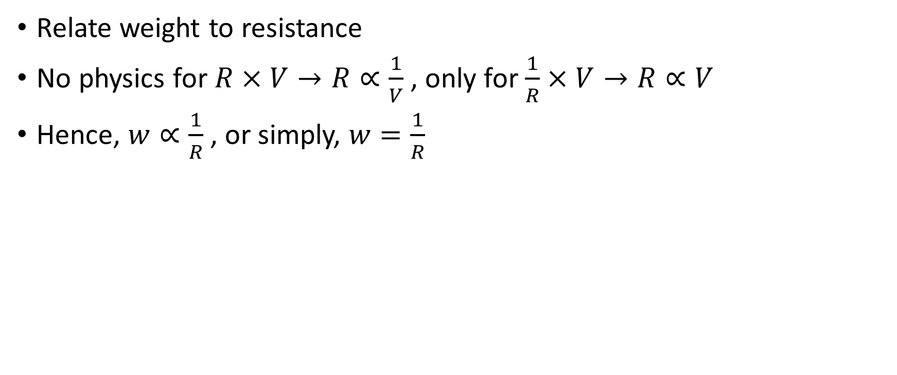
Practically and Physically …
Relate weight to resistance
No physics for $R×V→R∝\frac{1}{V}$ , only for $\frac{1}{R}×V→R∝V$
Hence, $w∝\frac{1}{R}$ , or simply, $w=\frac{1}{R}$

Slide 25

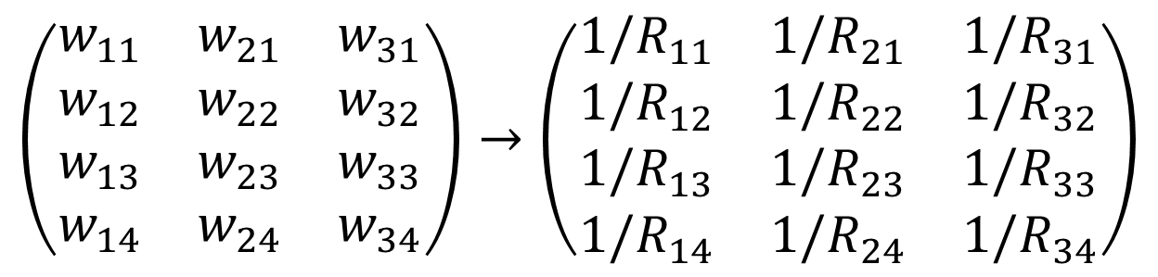
Weight $→$ Resistance
$$\left(\begin{matrix}w_{11} & w_{21} & w_{31} \\ w_{12} & w_{22} & w_{32} \\ w_{13} & w_{23} & w_{33} \\ w_{14} & w_{24} & w_{34}\end{matrix}\right)→\left(\begin{matrix}{1/R}_{11} & {1/R}_{21} & {1/R}_{31} \\ {1/R}_{12} & {1/R}_{22} & {1/R}_{32} \\ {1/R}_{13} & {1/R}_{23} & {1/R}_{33} \\ {1/R}_{14} & {1/R}_{24} & {1/R}_{34}\end{matrix}\right)$$
$$R=1/w$$

Slide 26
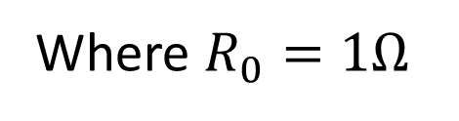
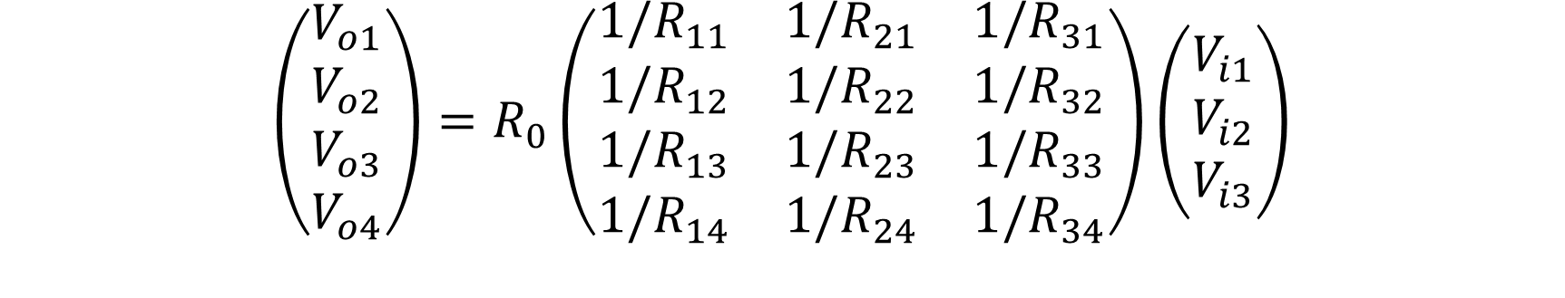
Matrix Operation
$$\left(\begin{matrix}V_{o1} \\ V_{o2} \\ V_{o3} \\ V_{o4}\end{matrix}\right)=R_{0}\left(\begin{matrix}{1/R}_{11} & {1/R}_{21} & {1/R}_{31} \\ {1/R}_{12} & {1/R}_{22} & {1/R}_{32} \\ {1/R}_{13} & {1/R}_{23} & {1/R}_{33} \\ {1/R}_{14} & {1/R}_{24} & {1/R}_{34}\end{matrix}\right)\left(\begin{matrix}V_{i1} \\ V_{i2} \\ V_{i3}\end{matrix}\right)$$
Where $R_{0}=1Ω$
Is that all for circuit design? Not so simple!

Slide 27
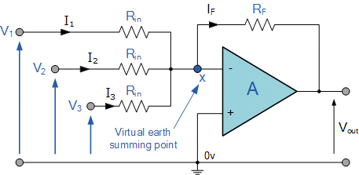
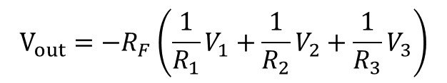
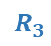
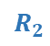
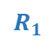
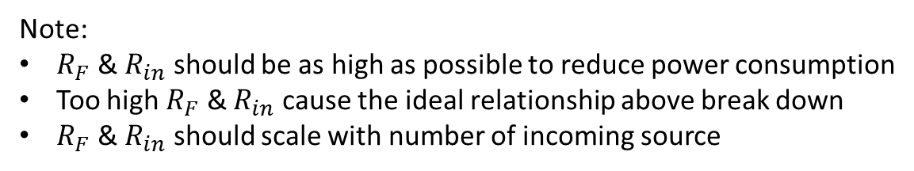
Inverting Summing OpAmp
$$R_{1}$$
$$R_{2}$$
$$R_{3}$$
Ideally,
$$V_{out}={−R}_{F}\left(\frac{1}{R_{1}}V_{1}+\frac{1}{R_{2}}V_{2}+\frac{1}{R_{3}}V_{3}\right)$$
Note:
$R_{F}$ & $R_{in}$ should be as high as possible to reduce power consumption
Too high $R_{F}$ & $R_{in}$ cause the ideal relationship above break down
$R_{F}$ & $R_{in}$ should scale with number of incoming source

Slide 28
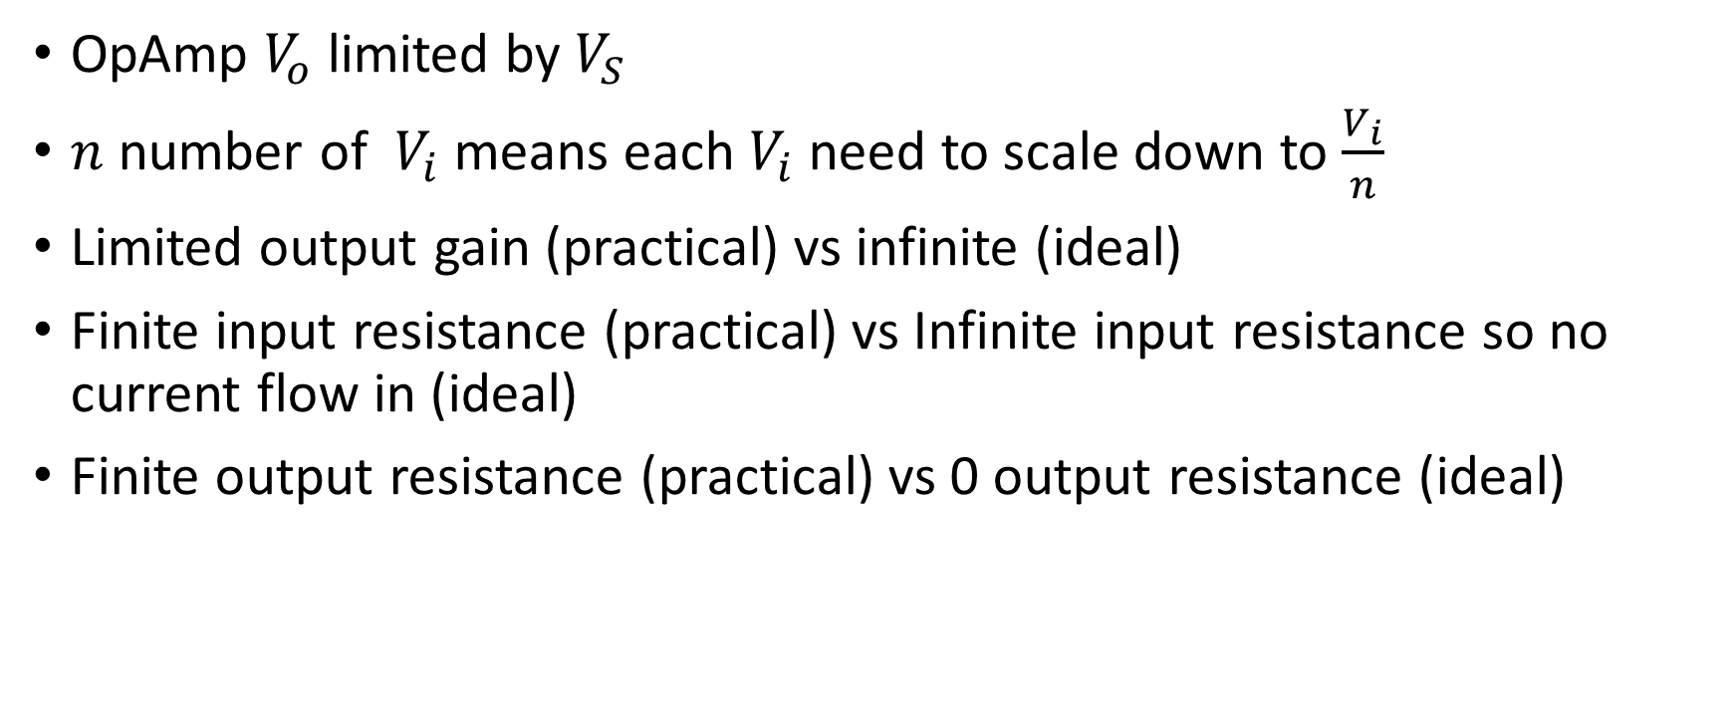
Practical OpAmp Limitation
OpAmp $V_{o}$ limited by $V_{S}$
$n$ number of $V_{i}$ means each $V_{i}$ need to scale down to $\frac{V_{i}}{n}$
Limited output gain (practical) vs infinite (ideal)
Finite input resistance (practical) vs Infinite input resistance so no current flow in (ideal)
Finite output resistance (practical) vs 0 output resistance (ideal)

Slide 29
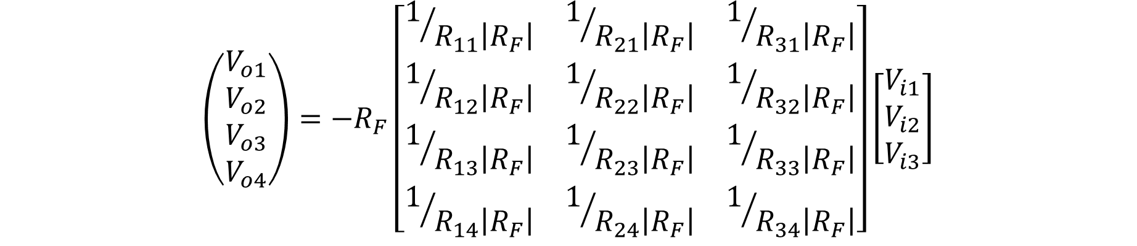
Matrix Operation (modified)
$$\left(\begin{matrix}V_{o1} \\ V_{o2} \\ V_{o3} \\ V_{o4}\end{matrix}\right)=−R_{F}\left[\begin{matrix}1/{R_{11}\left|R_{F}\right|} & 1/{R_{21}\left|R_{F}\right|} & 1/{R_{31}\left|R_{F}\right|} \\ 1/{R_{12}\left|R_{F}\right|} & 1/{R_{22}\left|R_{F}\right|} & 1/{R_{32}\left|R_{F}\right|} \\ 1/{R_{13}\left|R_{F}\right|} & 1/{R_{23}\left|R_{F}\right|} & 1/{R_{33}\left|R_{F}\right|} \\ 1/{R_{14}\left|R_{F}\right|} & 1/{R_{24}\left|R_{F}\right|} & 1/{R_{34}\left|R_{F}\right|}\end{matrix}\right]\left[\begin{matrix}V_{i1} \\ V_{i2} \\ V_{i3}\end{matrix}\right]$$

Slide 30
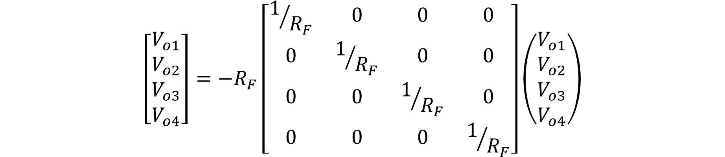
Matrix Operation (modified)
$$\left[\begin{matrix}V_{o1} \\ V_{o2} \\ V_{o3} \\ V_{o4}\end{matrix}\right]=−R_{F}\left[\begin{matrix}1/{R_{F}} & 0 & 0 & 0 \\ 0 & 1/{R_{F}} & 0 & 0 \\ 0 & 0 & 1/{R_{F}} & 0 \\ 0 & 0 & 0 & 1/{R_{F}}\end{matrix}\right]\left(\begin{matrix}V_{o1} \\ V_{o2} \\ V_{o3} \\ V_{o4}\end{matrix}\right)$$
Look redundant in math? This is a must in circuit implementation!

Slide 31
65nm Process Design Kit

Slide 32
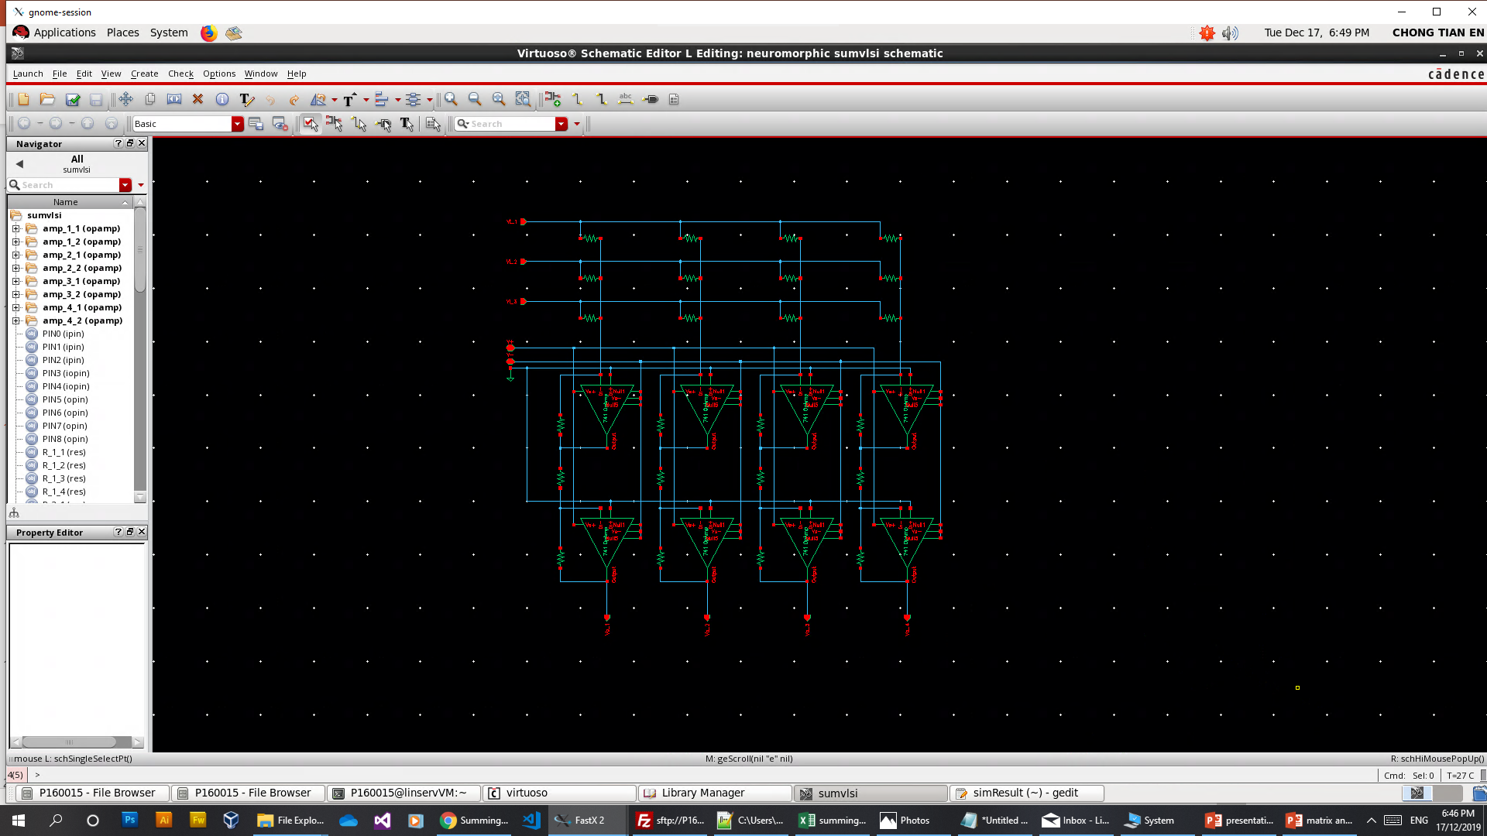
Cadence Development Environment

Slide 33
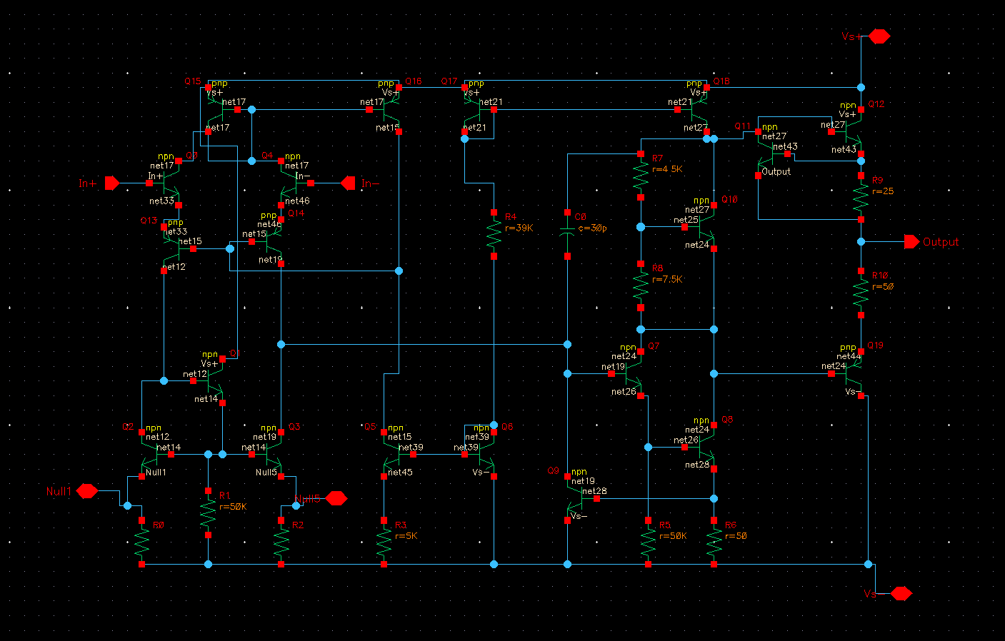
741 OpAmp Model

Slide 34
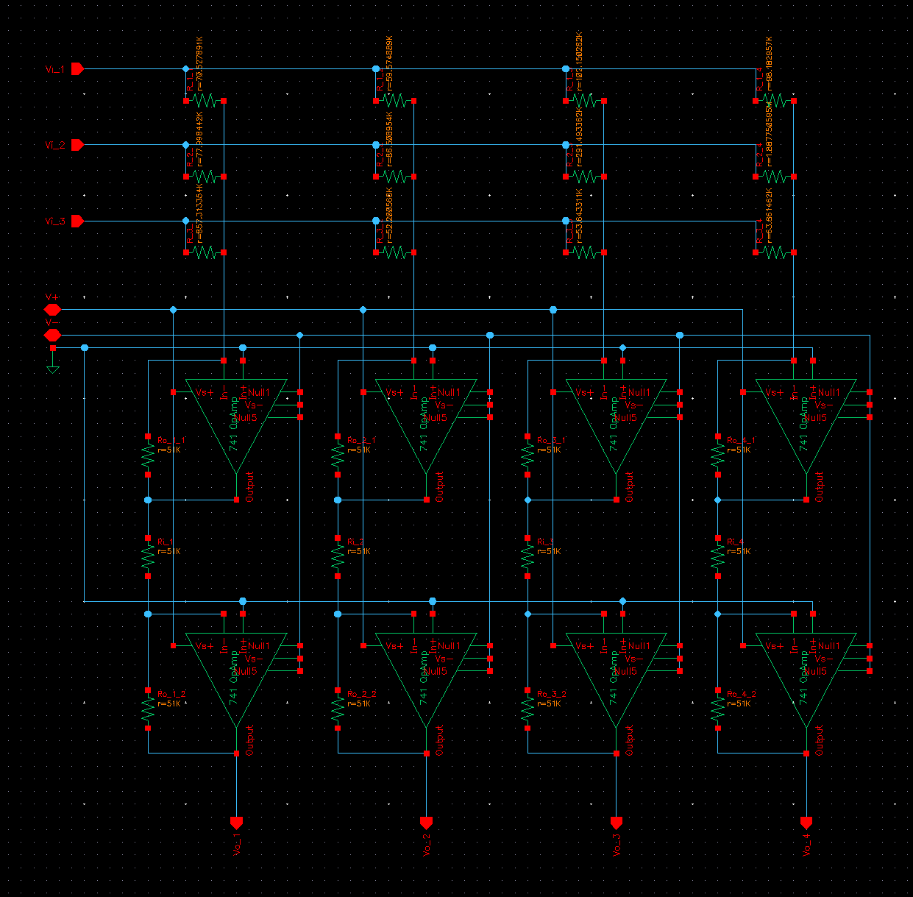
3 by 4 synapses
4 neurons
Note:
Matrix in n by m dimension due to diagonal flipping

Slide 35
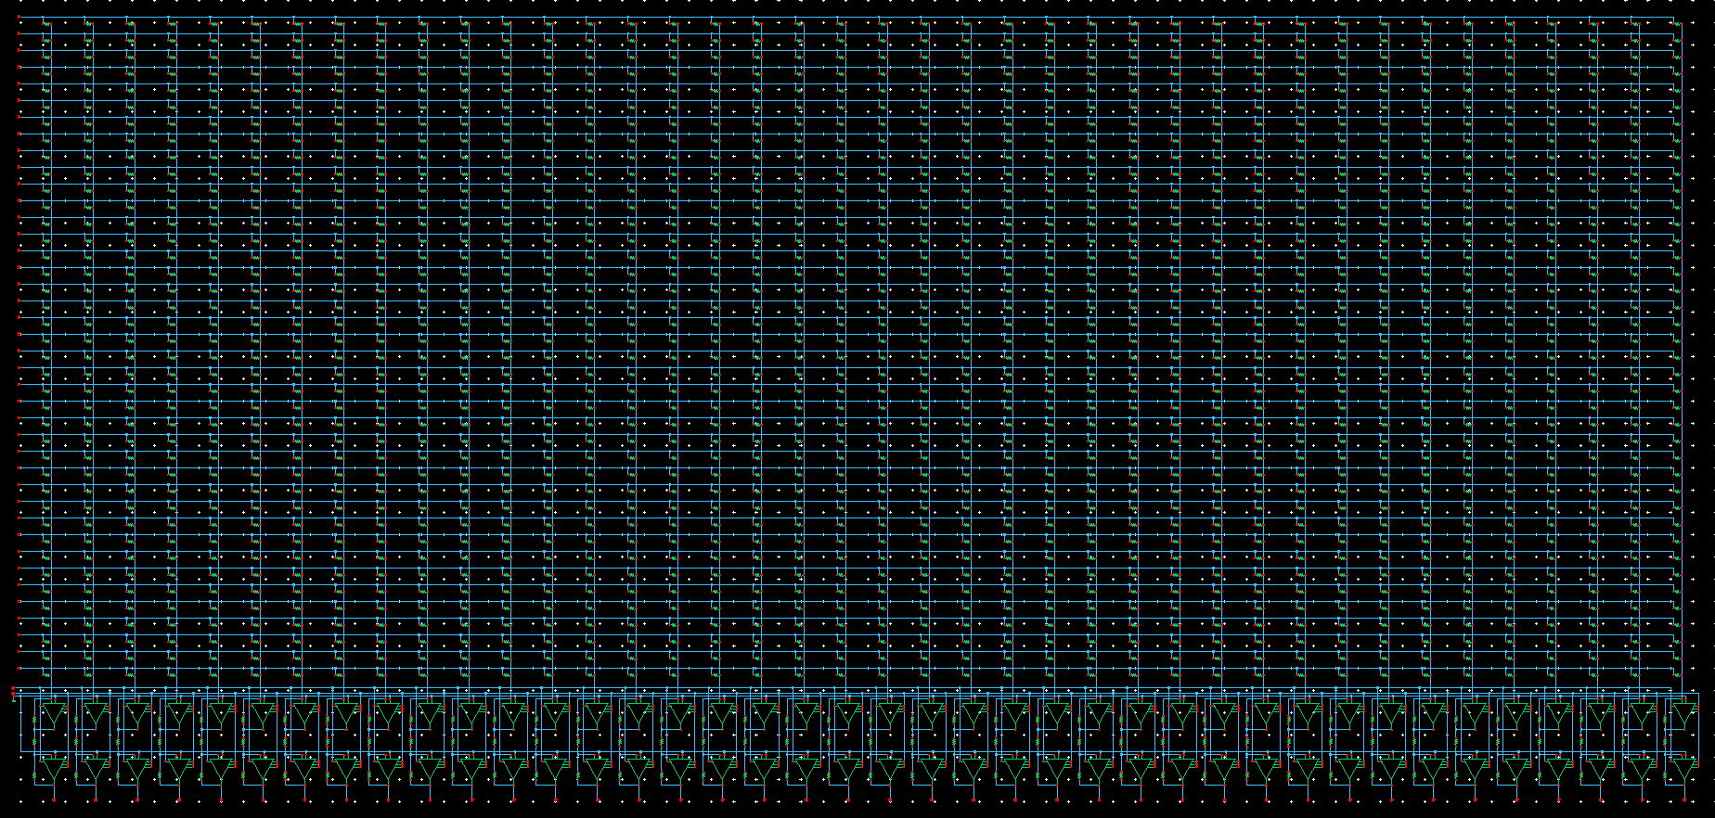
40 by 40 synapses
40 neurons

Slide 36
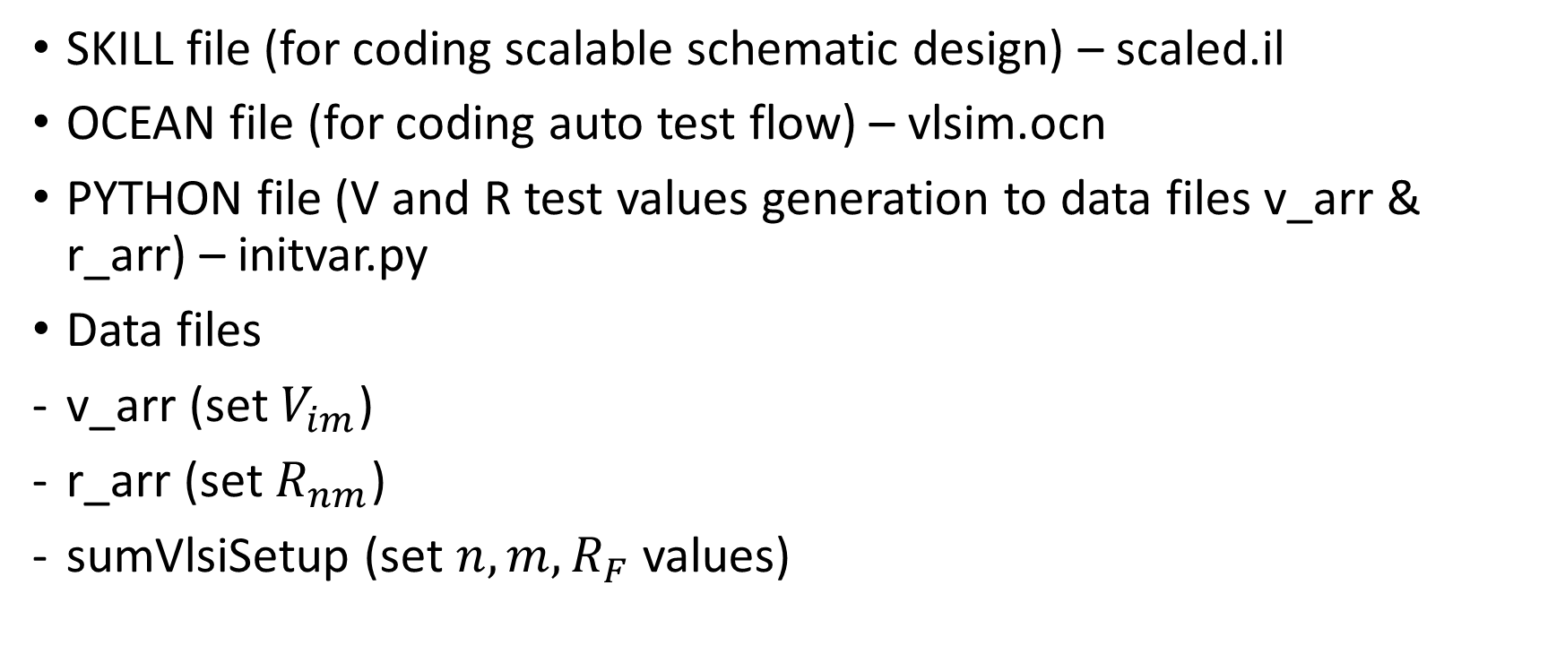
Code Files
SKILL file (for coding scalable schematic design) – scaled.il
OCEAN file (for coding auto test flow) – vlsim.ocn
PYTHON file (V and R test values generation to data files v_arr & r_arr) – initvar.py
Data files
v_arr (set $V_{im}$)
r_arr (set $R_{nm}$)
sumVlsiSetup (set $n,m,R_{F}$ values)

Slide 37
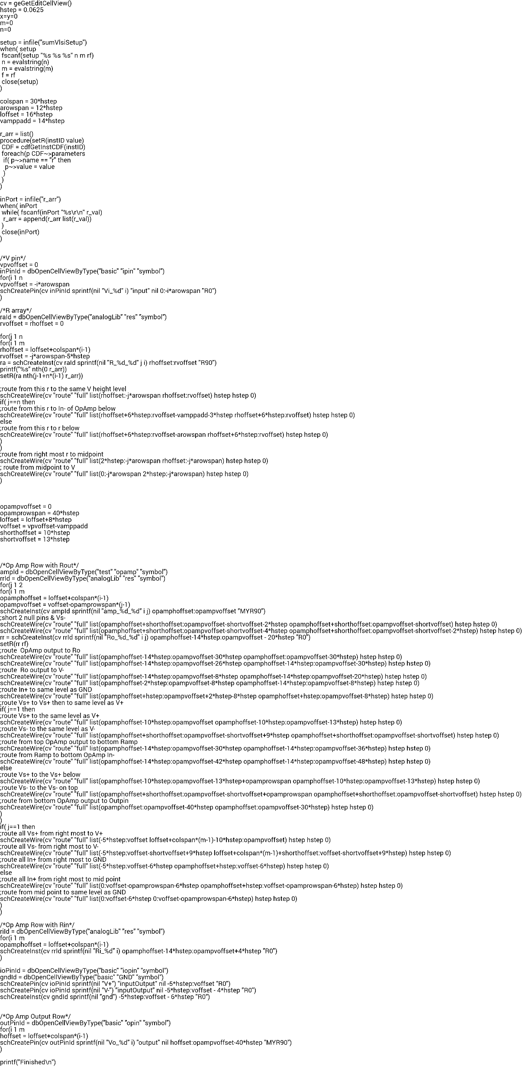
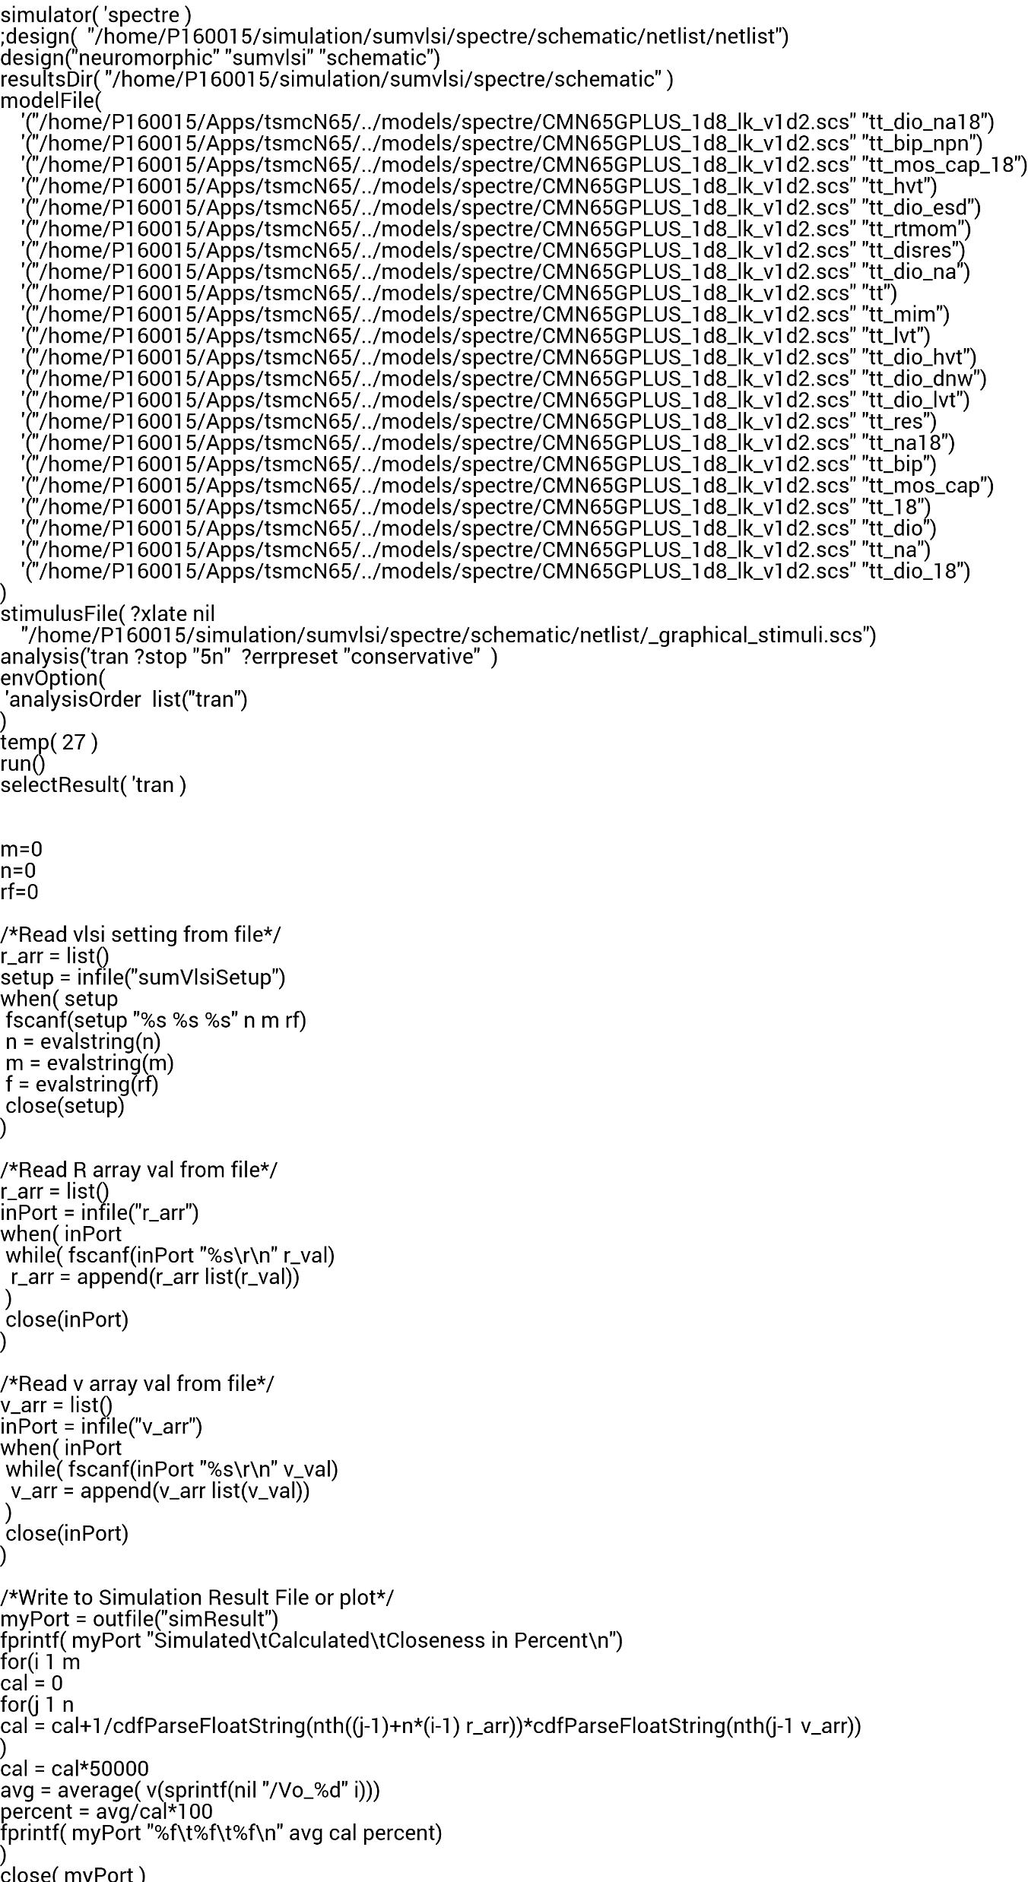
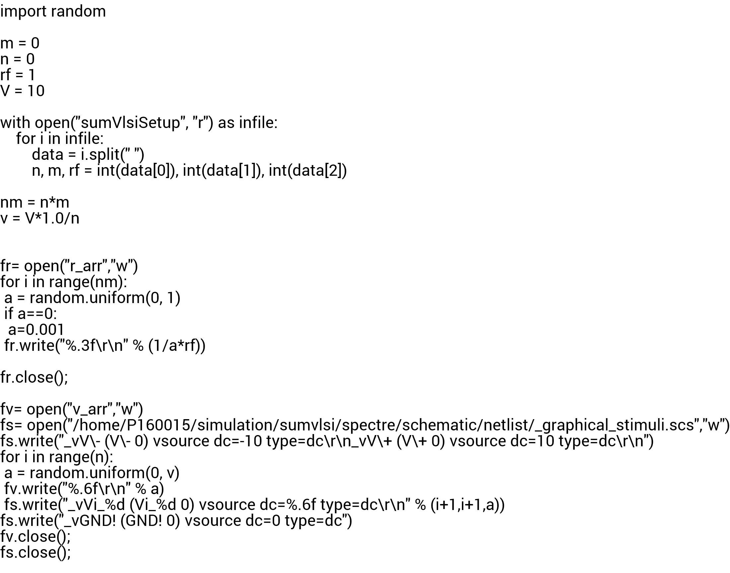

scaled.il
vlsim.ocn
initvar.py

Slide 38
Results

Slide 39
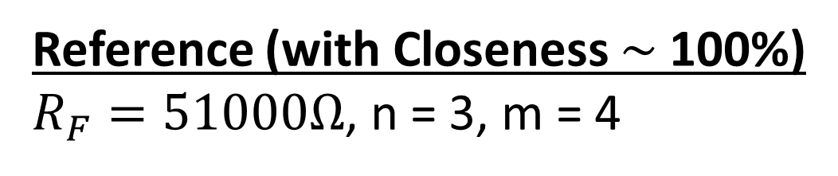
Reference (with Closeness $\sim$ 100%)
$R_{F}=51000Ω$, n = 3, m = 4
Simulated Calculated Closeness in %
0.565875 0.580128 97.543117
2.782740 2.858339 97.355158
2.505678 2.538183 98.719345
2.080225 2.096747 99.212025

Slide 40
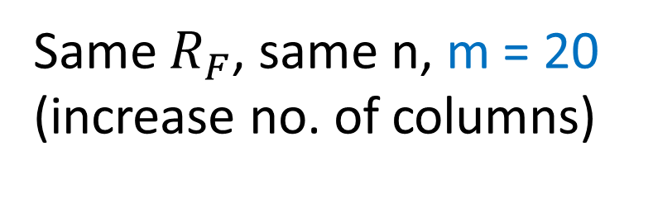
Same $R_{F}$, same n, m = 20 (increase no. of columns)
Simulated Calculated Closeness in %
3.382832 3.455852 97.887077
2.492031 2.514025 99.125146
2.050317 2.056614 99.693787
4.055174 4.152284 97.661288
1.997813 2.010950 99.346700
2.287353 2.307829 99.112730
1.711722 1.723161 99.336167
2.314272 2.342073 98.812965
1.607062 1.608447 99.913893
2.818629 2.866287 98.337294
3.855918 3.950264 97.611663
1.690216 1.683556 100.395546
0.647803 0.625310 103.596977
3.007529 3.061375 98.241130
2.609220 2.641702 98.770396
1.731220 1.735840 99.733862
0.967000 0.948559 101.944104
2.770710 2.808790 98.644242
3.414040 3.480872 98.080017
2.507560 2.530245 99.103453

Slide 41
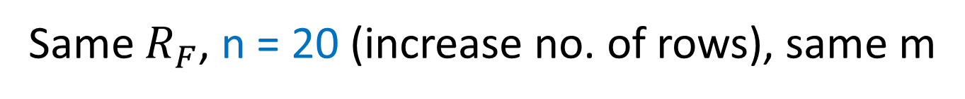
Same $R_{F}$, n = 20 (increase no. of rows), same m
Simulated Calculated Closeness in %
2.407520 2.786503 86.399331
3.148906 3.764218 83.653647
2.389537 2.752610 86.809858
2.271663 2.651160 85.685643

Slide 42
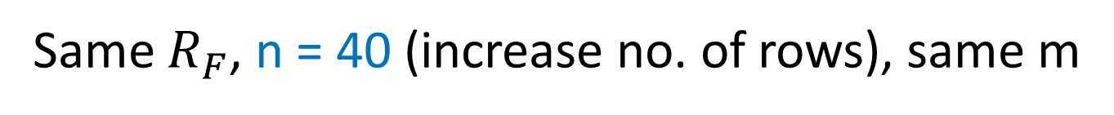
Same $R_{F}$, n = 40 (increase no. of rows), same m
Simulated Calculated Closeness in %
1.414525 2.182415 64.814665
1.351934 2.086400 64.797425
1.360665 2.030461 67.012634
1.474293 2.237327 65.895287

Slide 43
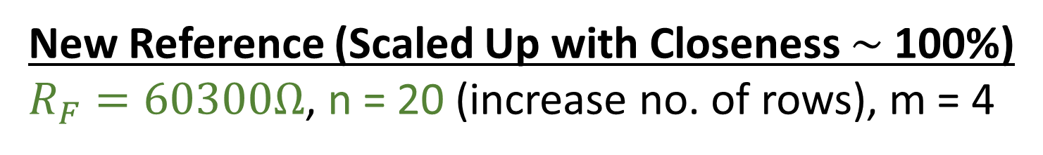
New Reference (Scaled Up with Closeness $\sim$ 100%)
$R_{F}=60300Ω$, n = 20 (increase no. of rows), m = 4
Simulated Calculated Closeness in %
2.461681 2.514250 97.909155
2.296731 2.346236 97.890015
1.903122 1.877480 101.365788
1.617127 1.650176 97.997250

Slide 44
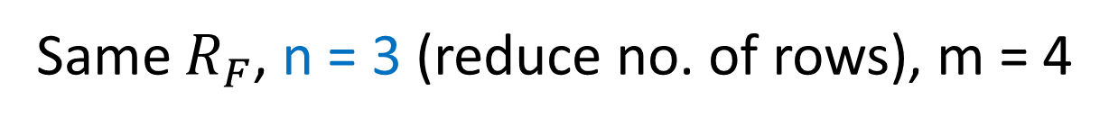
Same $R_{F}$, n = 3 (reduce no. of rows), m = 4
Simulated Calculated Closeness in %
3.208478 2.740139 117.091776
2.595280 2.244113 115.648334
1.339105 1.128274 118.686145
3.210356 2.737751 117.262518

Slide 45
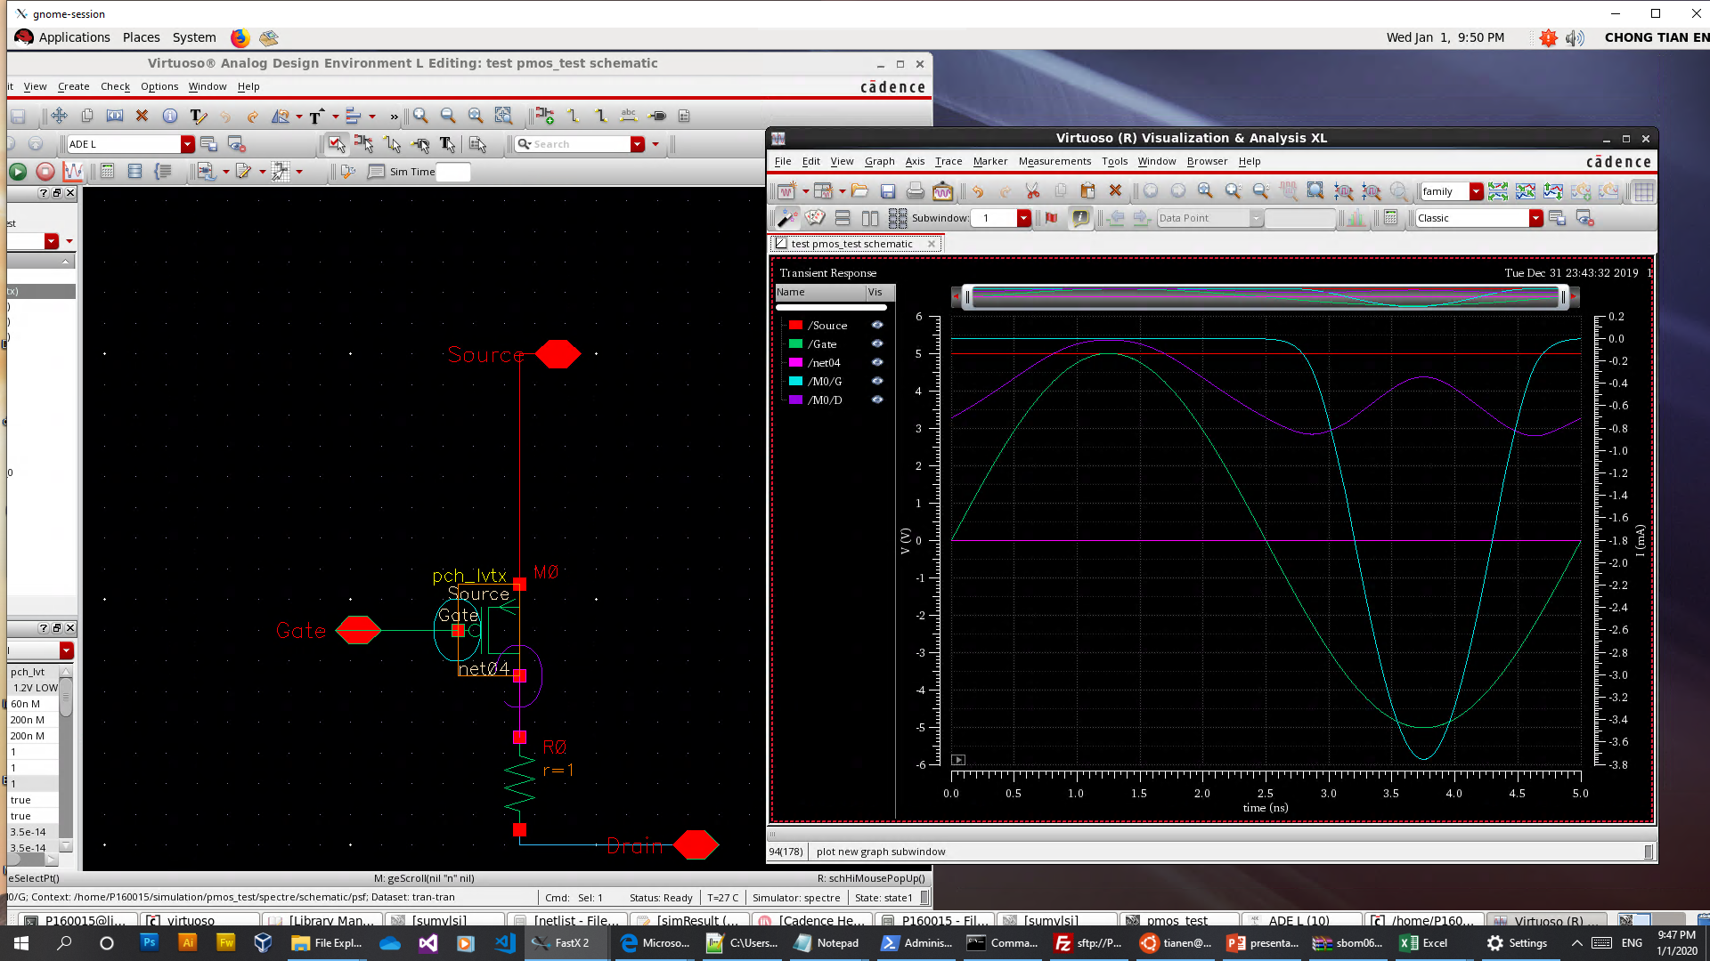
MOSFET Experimentation

Slide 46
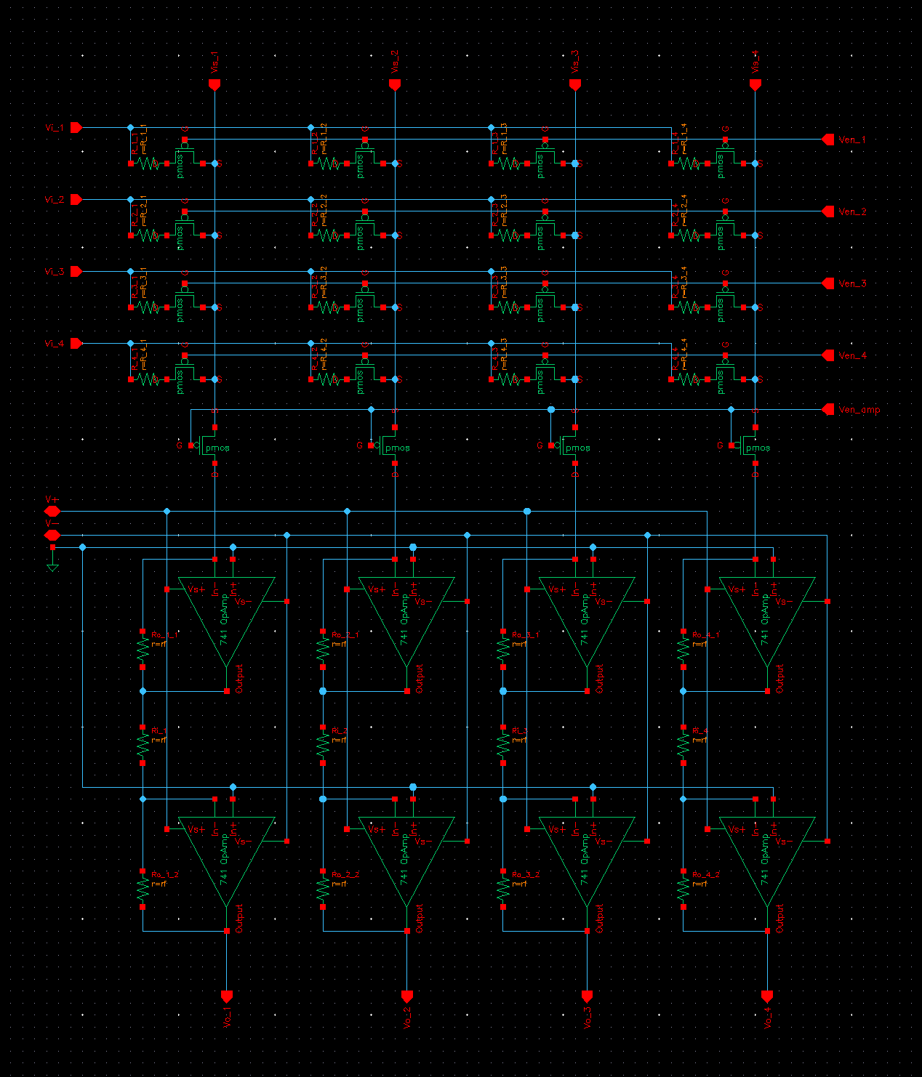
Programmable Scalable Network

Slide 47
Discussion

Slide 48
Ideally, what do we want?
Infinite circuit scaling
Means 100% matched values with 0 error or standard deviation

Slide 49
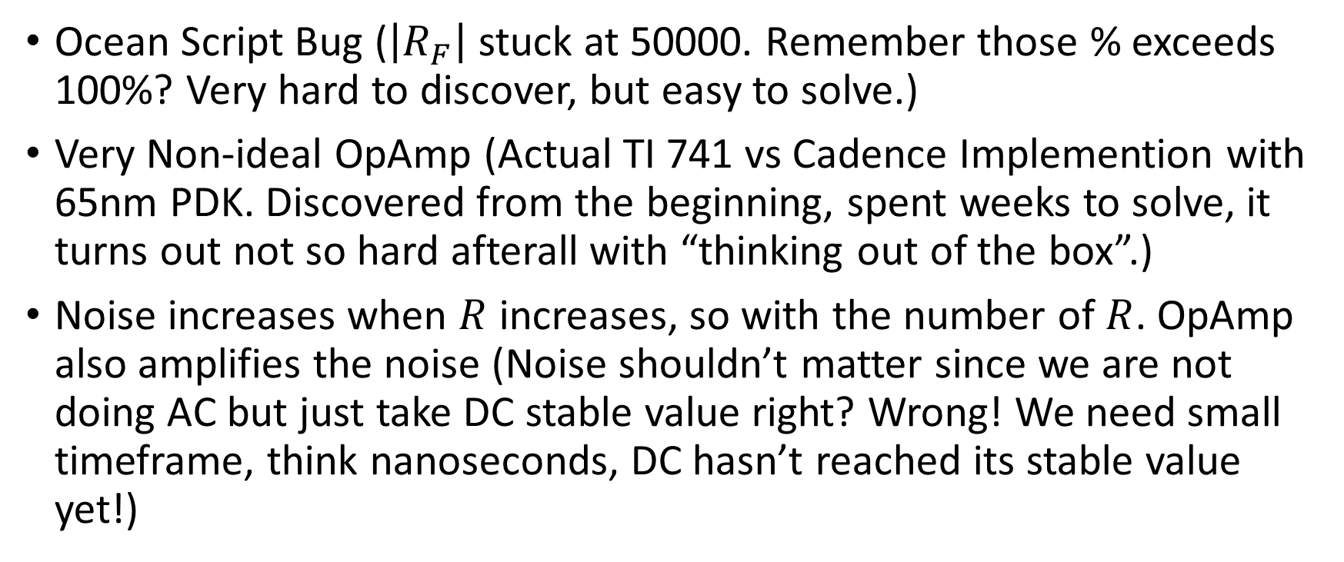
Based on Previous Result, What’s Wrong?
Ocean Script Bug ($\left|R_{F}\right|$ stuck at 50000. Remember those % exceeds 100%? Very hard to discover, but easy to solve.)
Very Non-ideal OpAmp (Actual TI 741 vs Cadence Implemention with 65nm PDK. Discovered from the beginning, spent weeks to solve, it turns out not so hard afterall with “thinking out of the box”.)
Noise increases when $R$ increases, so with the number of $R$. OpAmp also amplifies the noise (Noise shouldn’t matter since we are not doing AC but just take DC stable value right? Wrong! We need small timeframe, think nanoseconds, DC hasn’t reached its stable value yet!)

Slide 50
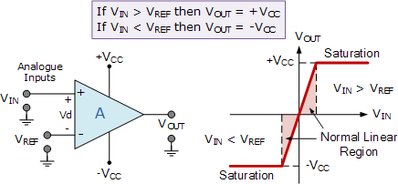
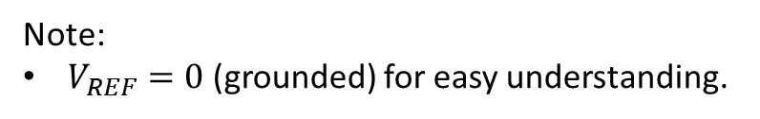
Ideal OpAmp (Just what we need to know enough to use)
Note:
$V_{REF}=0$ (grounded) for easy understanding.

Slide 51
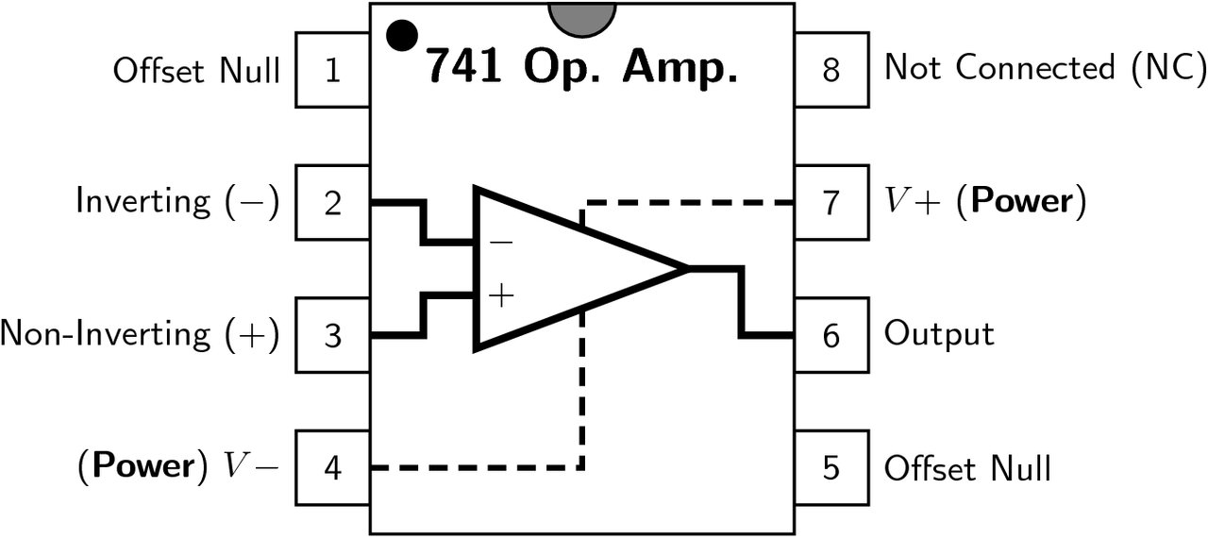
TI OpAmp 741 Package

Slide 52
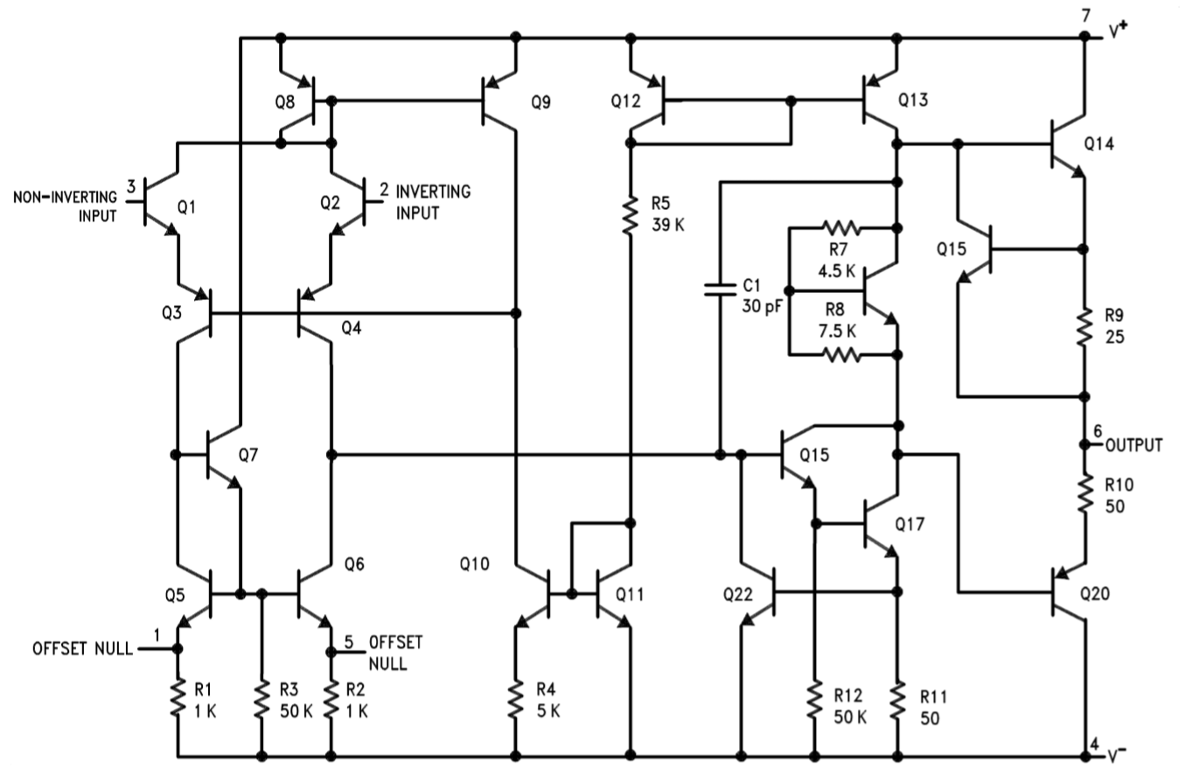
TI OpAmp 741 Schematic

Slide 53

Offset Null Tuning
Basically, we can add resistor with appropriate resistance in parallel with those 2 $1K$ resistors.
So that $V_{in}=0,V_{out}=0$

Slide 54

What so difficult to tune then?
No number of resistance added in parallel can change the $V_{out}$ close to 0 significantly.
Due to the relationship:
$$R_{effective}=\frac{1kΩ×R_{added}}{1kΩ+R_{added}}$$

Slide 55



Effective Resistance Graph (${0≤R}_{effective}≤1000$)
Note:
$R_{added}=x$

Slide 56

What to do then?
Simple, just tune one of the $1k$ resistor until we reaches $V_{out}≈0$
And it works! Previously, our measurement starts to go hay wire when $n≈16$ (I am not showing you those rubbish results), the graph later will show how far we have come with extended range and lower error.

Slide 57


Slide 58


Circuit scaling and $R_{F}$ [Old Assumption]
$$n∝R_{F}$$
No more or less. Must be just right.
Due to power consumption? Non-ideal effect?

Slide 59



Circuit scaling and $R_{F}$
Note:
Good $R_{F}$ value means close to 100% with low error.
$R$ here means $R_{F}$.
Model xycube3 (User)
Equation a*(x^3)*(y^3)+b*(x^3)*(y^2)+c*(x^3)*y+d*(x^3)+e*(x^2)*(y^3)+f*(x^2)*(y^2)+g*(x^2)*y+h*(x^2)+i*x*(y^3)+j*x*(y^2)+k*x*y+l*x+m*(y^3)+n*(y^2)+o*y+p
Reduced Chi-Sqr 714.846761334228
Adj. R-Square 0.88555125529964
Value Standard Error
Percentage a -3.40118964147559E-23 4.44279966677437E-22
Percentage b -3.3808777225304E-17 8.2557808192898E-16
Percentage c -2.0259689587371E-12 3.61725948885066E-10
Percentage d 3.05421829039265E-7 3.11204579295629E-5
Percentage e 1.92465908629804E-20 1.64731730408421E-19
Percentage f -1.55450903885609E-14 3.06407421899329E-13
Percentage g 1.13182576777577E-8 1.34640724225518E-7
Percentage h -3.85131129416287E-4 0.0114965996521702
Percentage i -1.48264432713436E-18 1.4260049552801E-17
Percentage j 1.33599679889964E-12 2.65612549419855E-11
Percentage k -1.4137600682012E-7 1.1725381816539E-5
Percentage l -0.260480613981356 0.989939319105463
Percentage m 5.92946586687354E-17 2.14080692056229E-16
Percentage n -9.87499996805226E-11 3.98894294313358E-10
Percentage o 4.46259065749002E-5 1.76439168641693E-4
Percentage p 93.4097157841867 14.8960306390529

Slide 60

Issues to be Resolved [Old]
Higher value of $R_{F}$ needed for larger scale summing amplifier
$R_{F}$ value that is too high can overshoot the computed V value and vice versa
For m = 1,
Power $\left(n=1\right)=\frac{V^{2}}{R×\left|R_{F}\right|}$
To maintain the same power consumption after scaling,
Power $=n\frac{{\left(\frac{V}{n}\right)}^{2}}{R×\left|R_{F}\right|}=\frac{V^{2}}{R×n\left|R_{F}\right|}⟹$ $\left|R_{F}\right|→\left|R_{F}/n\right|$

Slide 61
Issues to be Resolved
Get 65nm PDK mosfet model to work (Strong gate current? Drain voltage 0 -> open circuit, mosfet not turning on?
Need mosfet to be used as a switch (not so ideal after all? These mosfet only add more noise and screw up our result further with lower scalability) to isolate resistors to program them individually

Slide 62


Slide 63
Planned Roadmap (subjected to change)
Develop a Single Simplified Spike-based Neuron Model
Spike-based Neuron Model Scaling
Implement Spintronic MRAM
MNIST Data Simulation & Comparison
Spike-based MNIST Data Simulation & Comparison

